Slide 1

The Basic Expectations in EVERY lesson
Be on time
Lanyard MUST be worn at all times
Mobile phones off and in bags
No food or drink in the classroom (except water)
Be prepared to learn for every lesson (pen, paper, folder etc.)
Sit according to the seating plan
Work hard
Be respectful
DO NOW
Is social media a benefit to a customer when resolving queries and managing issues.
Explain your answer using a sentence
C- Connecting what you know already
O- Online Learning, using sites like Canvas
N-Use Cornell notes for your note taking
S – Spacing out your learning over time
I- Interleaving your subjects and topics to make connections
D-Dual Coding your ideas through words and images
E- Elaborating by always asking Why? and How?
R- Retrieve

Slide 2
Unit 3:- Using Social Media in Business
25 March 2025
11 & 18 March 2025

Slide 3
The Basic Expectations in EVERY lesson
Be on time
Lanyard MUST be worn at all times
Mobile phones off and in bags
No food or drink in the classroom (except water)
Be prepared to learn for every lesson (pen, paper, folder etc.)
Sit according to the seating plan
Work hard
Be respectful
DO NOW
Q/A
C- Connecting what you know already
O- Online Learning, using sites like Canvas
N-Use Cornell notes for your note taking
S – Spacing out your learning over time
I- Interleaving your subjects and topics to make connections
D-Dual Coding your ideas through words and images
E- Elaborating by always asking Why? and How?
R- Retrieve

Slide 4
Aims/Objectives
What: Justify what you have stated in your report for your given organisation.
Create your social media platform
How: Create a report reflecting on the feedback you received from colleagues.
Using the social media platform stated in your report or fake social media
Why: To enable you to review/justify your choices based on yours and others feedback.
To show the impact of social media on audiences.

Slide 5
What is Social Media
Social media are websites that allow people to interact & share information.
They allow us to form online communities and perform social networking.

Slide 6






Task 2 – Produce a plan to use social media in a business to meet its business requirements
Facebook
X (Twitter)
A small businesses has asked you to plan and implement the use of social media within their business.
Introduction
I have been asked by the Chamber of Commerce to create a Social Media platform for (Name of your organisation)
Business Requirements
What is your chosen business going to use Social Media for?
Is it to sell the product, Create an image
Social Media
What Social Media do you need? Choose 2 and state why
Success Criteria
How will you measure the success. What do you want to achieve in the first 6 months?
Timescale and responsibilities
Have a plan of what you are going to do and when. See table on page 197. You will need to explain the reasons why you are doing what you stated.
Instagram
Youtube
Pinterest
Linkedin

Slide 7
Task 2 – Produce a plan to use social media in a business to meet its business requirements
Facebook
X (Twitter)
Target Audience
Who is your target audience, who is interested in your Product/Service (Age, Gender, Interest, Income).
linking type of content to target audience to ensure it is engaging
Researching keywords (e.g. Google AdwordsTM) and creating keyword strategies to help users identify content
Developing an online community
Develop a strategy to encourage online community building, including:
Use of promotional techniques, e.g. requesting feedback, surveys, special offers and creating links between social media websites and company e-commerce site
Monitoring social media website streams and responding to queries, requests and complaints.
Instagram
Youtube
Pinterest
Linkedin

Slide 8
Task 2 – Produce a plan to use social media in a business to meet its business requirements
Facebook
X (Twitter)
Timings
When are you going to post content. Identify what is the best time for the platforms you have chosen and state why. Create a table of timings, see page Page 202 fig 3.4
Developing a Social Media Policy
Company Image/Philosophy (environmentally friendly),
Guidelines for Content, Confidentiality
Security.
Instagram
Youtube
Pinterest
Linkedin

Slide 9
Review the plan with others in order to identify and inform improvements.
In your groups you will need to review each others work.
Ensure you state whose work you are reviewing.

Slide 10
Review the plan with others in order to identify and inform improvements.
Groups
Daquan | Juan | Najah
Idriss | Vlad | Arda
Filip | Rei | Ahmad
Adam | Eliman | Yeabe
Israel | Suraj | Chris
Kenneth | Gerrald | Bryan
Amiin | Marwan

Slide 11
Task
Extension
Plan how your social media platform will look.
What font will you use.
What images will you include
Will you have a promotion to encourage customers to follow.
Explain your points.
If you have not created your report, you need to complete this.
Ensure your report has been reviewed.
Justify planning decisions made, showing how the plan will fulfil its purpose and business requirements.
Create a report in MS Word
Refer back to P3, why did you state what you have written. How will the plan fulfil its purpose. Also refer to the feedback given (P4)
Benefit to the organisation using the chosen social media
Timescale & responsibility
Target audience
Responding to queries/complaints

Slide 12
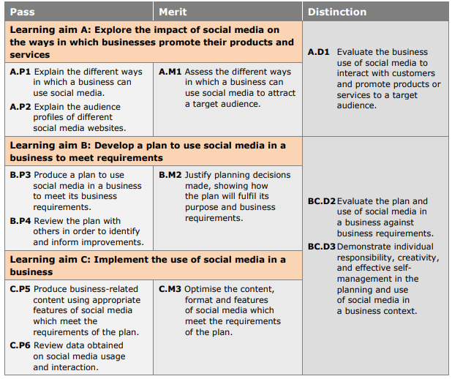
Assessment Criteria

Slide 13
Review - What you should have completed.
Facebook
X (Twitter)
P1:- Explain the different ways in which a business can use social media. (You must include all and give real-life example)
Creating an image or brand
Promoting products and/or services and creating an image or brand
Communicating with customers
Customer services
Resolving queries and managing issues
P2:- Explain the audience profiles of different social media websites
You need to research the different audience profiles for the main social media sites.
Facebook, Twitter, Instagram, Youtube, Linkedin, Pinterest
Explain how the social media sites appeal to different audiences
Use numerical/graphical information
Instagram
Youtube
Pinterest
Linkedin

Slide 14
Review - What you should have completed.
Facebook
X (Twitter)
M1:- Assess the different ways in which a business can use social media to attract a target audience
Promotion of products
Building relationships
Develop audiences and encourage people to follow or like
Direct and indirect advertising
Instagram
Youtube
Pinterest
Linkedin

Slide 15
Unit 3:- Using Social Media in Business
6 May 2025
22 April 2025

Slide 16
The Basic Expectations in EVERY lesson
Be on time
Lanyard MUST be worn at all times
Mobile phones off and in bags
No food or drink in the classroom (except water)
Be prepared to learn for every lesson (pen, paper, folder etc.)
Sit according to the seating plan
Work hard
Be respectful
DO NOW
Q/A
C- Connecting what you know already
O- Online Learning, using sites like Canvas
N-Use Cornell notes for your note taking
S – Spacing out your learning over time
I- Interleaving your subjects and topics to make connections
D-Dual Coding your ideas through words and images
E- Elaborating by always asking Why? and How?
R- Retrieve

Slide 17
Aims/Objectives
What: Create your social media platform
How: Using the social media platform stated in your report or fake social media
Why: To show the impact of social media on audiences.

Slide 18
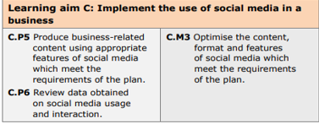
Creating your Social Media platform
Create your social media
Show evidence of communication with your audience

Slide 19
Create your social media
Create your social media
https://www.prankmenot.com/?facebook_status
https://www.tweetgen.com/
https://generatestatus.com/generate-fake-instagram-post/
Submission for P5 & P6
Tuesday 29 April 2025 – by 12:45 rescheduled due to work experience to Thursday 8 May 2025 by 21:00pm
Show evidence of communication with your audience

Slide 20
Social Media Platform
https://www.prankmenot.com/?facebook_status
https://www.tweetgen.com/
https://generatestatus.com/generate-fake-instagram-post/

Slide 21
Plenary
What impact does social media have on you.

